Slide 1
Blacktown Chinese Christian Church
Welcome to Our English Service 09.02.2025
English Service 9:45 – 11:00 am
Worship Songs: Passage: Speaker: Topic: Response Song: Announcements and Closing Prayer Benediction
Hosanna Shoulders King Of Kings Genesis 4:2-8 Heb 11:4 T TBA TBA TBA

Slide 2
BCCC english service

Slide 3

Please keep all phones on silent

Slide 4
Hosanna
Brooke Ligertwood ©2006 Hillsong Music Publishing Australia CCLI Licence No. 5485849. CCLI Song number: 4785835

Slide 5
Verse 1
I see the King of glory
Coming on the clouds with fire
The whole earth shakes
The whole earth shakes yeah

Slide 6
Verse 2
I see His love and mercy
Washing over all our sin
The people sing
The people sing

Slide 7
Chorus
Hosanna hosanna
Hosanna in the highest
Hosanna hosanna
Hosanna in the highest

Slide 8
Verse 3
I see a generation
Rising up to take their place
With selfless faith
With selfless faith

Slide 9
Verse 4
I see a near revival
Stirring as we pray and seek
We're on our knees
We're on our knees

Slide 10
Chorus
Hosanna hosanna
Hosanna in the highest
Hosanna hosanna
Hosanna in the highest

Slide 11
Bridge
Heal my hеart and make it clean
Open up my еyes to the things unseen
Show me how to love like You have loved me

Slide 12
Bridge
Break my heart for what breaks Yours
Everything I am for Your Kingdom's cause
As I walk from earth into eternity

Slide 13
Chorus
Hosanna hosanna
Hosanna in the highest
Hosanna hosanna
Hosanna in the highest

Slide 14
Tag
Hosanna in the highest

Slide 15
Shoulders
Ben Glover, Joel Smallbone, Luke Smallbone, Tedd T. © Curb Dayspring Music (Admin. by CopyCare Pacific Pty. Ltd.) CCLI Licence No. 5485849 . CCLI Song number: 7028523

Slide 16
Verse 1
When confusion's my companion
And despair holds me for ransom
I will feel no fear
I know that You are near

Slide 17
Verse 2
When I'm caught deep in the valley
With chaos for my company
I'll find my comfort here
‘Cause I know that You are near

Slide 18
Chorus
My help comes from You
You're right here, pulling me through

Slide 19
Chorus
You carry my weakness, my sickness,
My brokenness all on Your shoulders
Your shoulders

Slide 20
Chorus
My help comes from You
You are my rest, my rescue

Slide 21
Chorus
I don't have to see to believe that
You're lifting me up on Your shoulders
Your shoulders

Slide 22
Verse 3
You mend what once was shattered
And You turn my tears to laughter
Your forgiveness is my fortress
Oh Your mercy is relentless

Slide 23
Chorus
My help comes from You
You're right here, pulling me through

Slide 24
Chorus
You carry my weakness, my sickness,
My brokenness all on Your shoulders
Your shoulders

Slide 25
Chorus
My help comes from You
You are my rest, my rescue

Slide 26
Chorus
I don't have to see to believe that
You're lifting me up on Your shoulders
Your shoulders

Slide 27
Bridge
My help is from You
(Don't have to see it to believe it)

Slide 28
Bridge
My help is from you
(Don't have to see it, cause I know,
cause I know it's true)

Slide 29
Bridge
My help is from You
(Don't have to see it to believe it)

Slide 30
Bridge
My help is from you
(Don't have to see it, cause I know,
cause I know it's true)

Slide 31
Chorus
My help comes from You
You're right here, pulling me through

Slide 32
Chorus
You carry my weakness, my sickness,
My brokenness all on Your shoulders
Your shoulders

Slide 33
Chorus
My help comes from You
You are my rest, my rescue

Slide 34
Chorus
I don't have to see to believe that
You're lifting me up on Your shoulders
Your shoulders

Slide 35
Bridge
My help is from You
(Don't have to see it to believe it)

Slide 36
Bridge
My help is from you
(Don't have to see it, cause I know,
cause I know it's true)

Slide 37
Bridge
My help is from You
(Don't have to see it to believe it)

Slide 38
Bridge
My help is from you
(Don't have to see it, cause I know,
cause I know it's true)

Slide 39
Bridge
My help is from You
(Don't have to see it to believe it)

Slide 40
Bridge
My help is from you
(Don't have to see it, cause I know,
cause I know it's true)

Slide 41
Bridge
My help is from You
(Don't have to see it to believe it)

Slide 42
Bridge
My help is from you
(Don't have to see it, cause I know,
cause I know it's true)

Slide 43
King Of Kings
Beau Lamshed, Jason Tarau © 2016 Citipointe Worship (Admin. by Crossroad Distributors Pty. Ltd.) CCLI Licence No. 5485849 . CCLI Song number: 7102191

Slide 44
Verse 1
In the darkness we were waiting
Without hope, without light
Till from heaven You came running
There was mercy in Your eyes

Slide 45
Verse 1
To fulfill the law and prophets
To a virgin came the word
From a throne of endless glory
To a cradle in the dirt

Slide 46
Chorus
Praise the Father, praise the Son
Praise the Spirit, three in one
God of glory, Majesty
Praise forever to the King of Kings

Slide 47
Verse 2
To reveal the kingdom coming
And to reconcile the lost
To redeem the whole creation
You did not despise the cross

Slide 48
Verse 2
For even in your suffering
You saw to the other side
Knowing this was our salvation
Jesus for our sake you died

Slide 49
Chorus
Praise the Father, praise the Son
Praise the Spirit, three in one
God of glory, Majesty
Praise forever to the King of Kings

Slide 50
Verse 3
And the morning that You rose
All of heaven held its breath
Till that stone was moved for good
For the Lamb had conquered death

Slide 51
Verse 3
And the dead rose from their tombs
And the angels stood in awe
For the souls of all who'd come
To the Father are restored

Slide 52
Verse 4
And the Church of Christ was born
Then the Spirit lit the flame
Now this gospel truth of old
Shall not kneel, shall not faint

Slide 53
Verse 4
By His blood and in His name
In His freedom I am free
For the love of Jesus Christ
Who has resurrected me

Slide 54
Chorus
Praise the Father, praise the Son
Praise the Spirit, three in one
God of glory, Majesty
Praise forever to the King of Kings

Slide 55
Outro
Praise forever to the King of Kings

Slide 56

Bible reading

Slide 57
Genesis 4:2-8
² Later she gave birth to his brother Abel.
Now Abel kept flocks, and Cain worked the soil. ³ In the course of time Cain brought some of the fruits of the soil as an offering to the Lord.

Slide 58
Genesis 4:2-8
⁴ And Abel also brought an offering—fat portions from some of the firstborn of his flock. The Lord looked with favor on Abel and his offering, ⁵ but on Cain and his offering he did not look with favor. So Cain was very angry, and his face was downcast.

Slide 59
Genesis 4:2-8
⁶ Then the Lord said to Cain, “Why are you angry? Why is your face downcast? ⁷ If you do what is right, will you not be accepted? But if you do not do what is right, sin is crouching at your door; it desires to have you, but you must rule over it.”

Slide 60
Genesis 4:2-8
⁸ Now Cain said to his brother Abel, “Let’s go out to the field.” While they were in the field, Cain attacked his brother Abel and killed him.

Slide 61
Heb 11:4
⁴ By faith Abel brought God a better offering than Cain did. By faith he was commended as righteous, when God spoke well of his offerings. And by faith Abel still speaks, even though he is dead.

Slide 62
Announcements

Slide 63





Account name: Blacktown Chinese Christian Church
Account number: 4216 50263
Offering
BSB: 112 - 879
Please put in "offering" as the reference
The offering box is available at the back of the hall

Slide 64
Prayer points

Slide 65
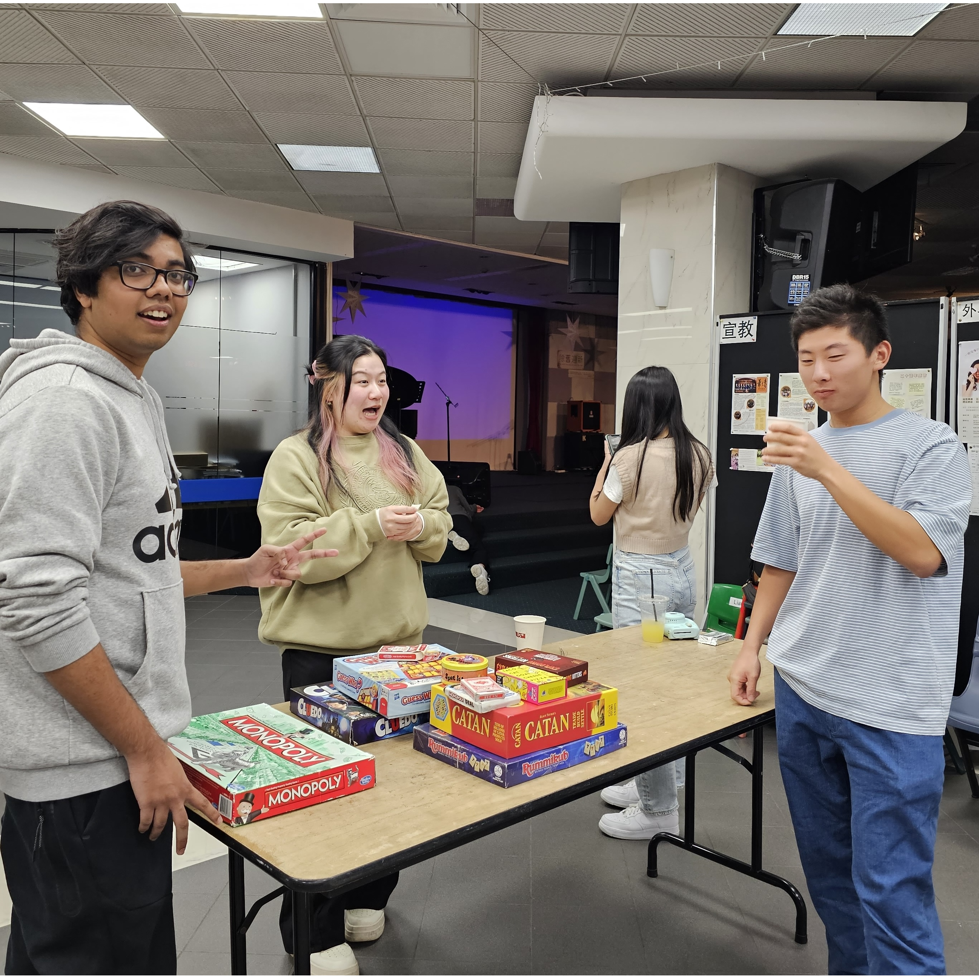
Mingle time!

